Slide 1
Advanced Industrial Design Engineering
GRAP2575
Lecturers: Nick Johns & Rick Butcher

Slide 2
Engineering for manufacture
Lean manufacturing
Design for disassembly and re-manufacture
Scalable, distributed and open-source modes of advanced and additive manufacturing
Mass-manufacture
Mass-customization
The social, cultural and environmental dimensions of product manufacturing and use will also be explored.

Slide 3
Show and Tell
If you find any interesting videos, websites or articles relating to manufacturing, materials or processes please share them.
Email a link to your lecturer
Will be uploaded onto myRMIT

Slide 4
Week #4 – Engineering Autopsy
Product Engineering Autopsy
Using the selected material maps (appendix - charts 1 to 6) categorise your materials/components based on the charts.
Document why specific materials were used in the product.
Identify whether alternative materials could have been used for specific components.
Task beyond class
Add info based on appendix charts into your autopsy report.
Collate assignment to myRMIT:
1 x stop motion video
1 x PDF or HTML document containing:
High quality image of disassembled product
Product/Component information – material type, manufacturing process, surface treatment, weight and dimensions
Material properties - BOM
Critical review of the product based on work undertaken thus far and design and technical elements of the product.
Read the prescribed Sustainable Design text(s).
To be uploaded onto myRMIT before the next class in week five.

Slide 5
Indexing products by attributes

Slide 6
Intentions in design
A single product may have more than one dominant intention, such as;
Market
For public / private use…
For women / elderly…
Economics
Minimum cost
Assembly
Sustainable
Recycling / biodegradability
Performance
Maximum Insulation

Slide 7
Material Selection - Boundaries
Define the boundary conditions
Functions:
Must it support a load?
Must it contain a pressure?
Must it transmit heat? Etc.

Slide 8
Material Selection - Boundaries
Define the boundary conditions
Functions:
Must it support a load?
Must it contain a pressure?
Must it transmit heat? etc.
Constraints:
Are certain dimensions fixed?
Must it carry the design loads without failure?
Must it insulate or conduct?
Can it function in a certain temperature range & in a given environment? Etc.

Slide 9
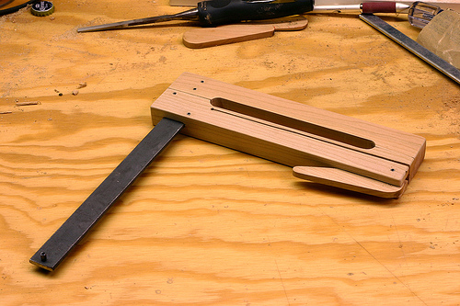
Material Selection - Boundaries
Define the boundary conditions
Functions:
Must it support a load?
Must it contain a pressure?
Must it transmit heat? etc.
Constraints:
Are certain dimensions fixed?
Must it carry the design loads without failure?
Must it insulate or conduct?
Can it function in a certain temperature range & in a given environment? etc.
Objectives:
to make it as cheap as possible?
to make it as light, or as safe as possible?
the least environmental impact?

Slide 10
Metals
Grand Arch II (1983).
Inge King
Powder coated steel, edition of 4 plus 1 artist's proof, 94.5 x 83.5 x 45 cm

Slide 11
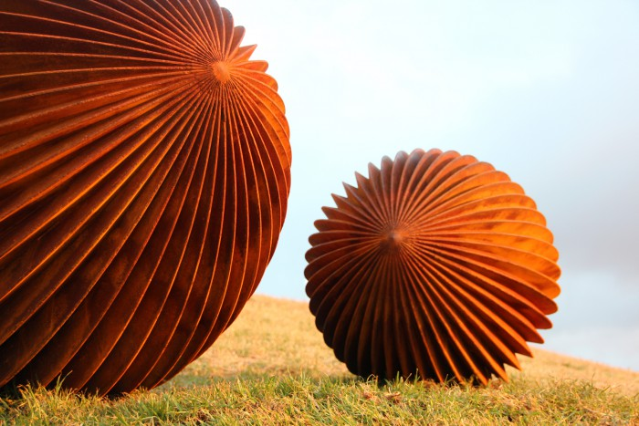
Metals
QUIESCENCE 2011.
Matthew Harding
Corten steel 160 x 110 cm dia, 85 x 60 cm dia Sculpture by the Sea 2011

Slide 12
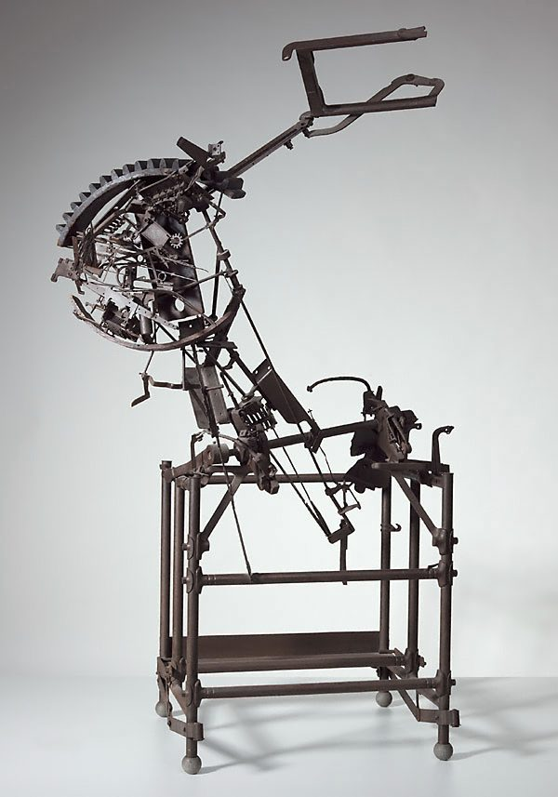
Metals
No 202 Metal construction.
Robert Klippel
Brazed and welded steel, found objects, 1966

Slide 13
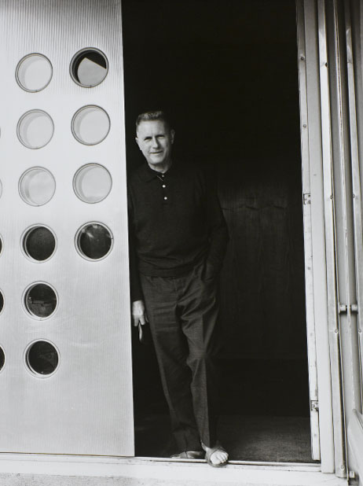
Metals
Jean Prouvé was once quoted saying: ‘never design anything that cannot be made.’

Slide 14
Metals
Hard, malleable, plastic and highly controllable, metals are also very strong and extremely good conductors of electricity and heat. (Sea of valence electrons)

Slide 15
Ceramics
Chilean studio Great Things to People (gt2P) has built a machine to generate pottery objects using an analogue version of parametric design.

Slide 16
Ceramics
Very hard and strong, but lack flexibility making them brittle. Extremely resistant to high temperatures and chemicals. Ceramics are usually not good conductors of electricity or heat.

Slide 17
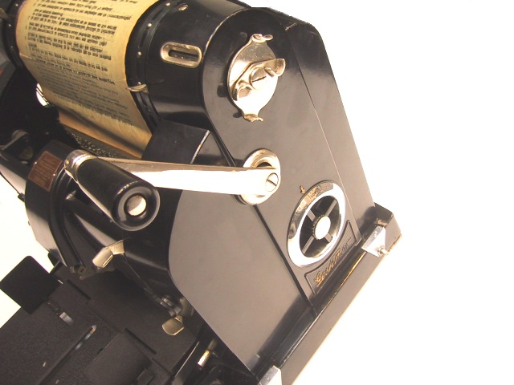
Polymers
Growing up in the 20thC with new plastics, including the Raymond Loewy designed Gestetner Mimeograph machine and the flexible Mr. Gumby and his talking horse Pokey! (modeled by Art Clokey)
One of the reasons for Gumby’s green color is that it represents chlorophyll, which turns light into life.

Slide 18
Poly-Mers
Mostly soft and not as strong as metals or ceramics. Polymers can be extremely flexible. Low density and viscous behavior under elevated temperatures are typical polymer traits. Polymers can be insulative to electricity.

Slide 19
Pine cells
Composites can be engineered to combine more features than monolithic materials. However, this can create macro and / or micro stresses which impact upon the eco-system.

Slide 20
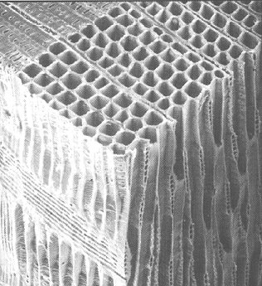
Yellow Pine cells
Koch, P. 1972a. Utilization of the southern pines. I. The raw material. USDA Forest Service Agricultural Handbook No. 420. 733 pp.
Koch, P. 1972b. Utilization of the southern pines. II. The raw material. USDA Forest Service Agricultural Handbook No. 420. 926 pp

Slide 21
Cellular material systems

Slide 22
Control and the fold

Slide 23
Material Selection - Free variables
Certain parameters can be adjusted in order to optimize the objective.
Where the designer is free to vary dimensions that are not constrained by design requirements.
Where the designer is free to choose the material for the component.
We refer to these as free variables.

Slide 24
Manufacturing boundaries
Manufacturing processes can also play a role in constraining the selection.
The designer may be interested in a material that can be processed in a specific way (such as the processes in use in the available manufacturing plant) therefore limiting the choice of materials.

Slide 25
Screen the attributes
Unbiased selection requires that all materials are considered to be candidates until shown to be otherwise.
Successful candidates must meet certain requirements or ‘attribute limits’.
Eliminate materials that cannot do the job.

Slide 26
Rank by ‘Material Indices’
Rank materials that do the job best
A material index measures how well a candidate that has passed the screening steps can perform, and therefore meet the objective
For example:
The best materials for buoyancy are those with the lowest density, .
those best for thermal insulation the ones with the smallest values of the thermal conductivity, .

Slide 27
Seek documentation
Typically descriptive, graphical or pictorial
Case studies of previous uses of the material
Details such as
Corrosion behavior
Availability
Pricing
Environmental impact
Design Standards
Such information is found in handbooks, suppliers’ data sheets, CD-based data sources and web sites.
Documentation helps match
Design requirements
Material attributes

Slide 28
Material Selection

Slide 29
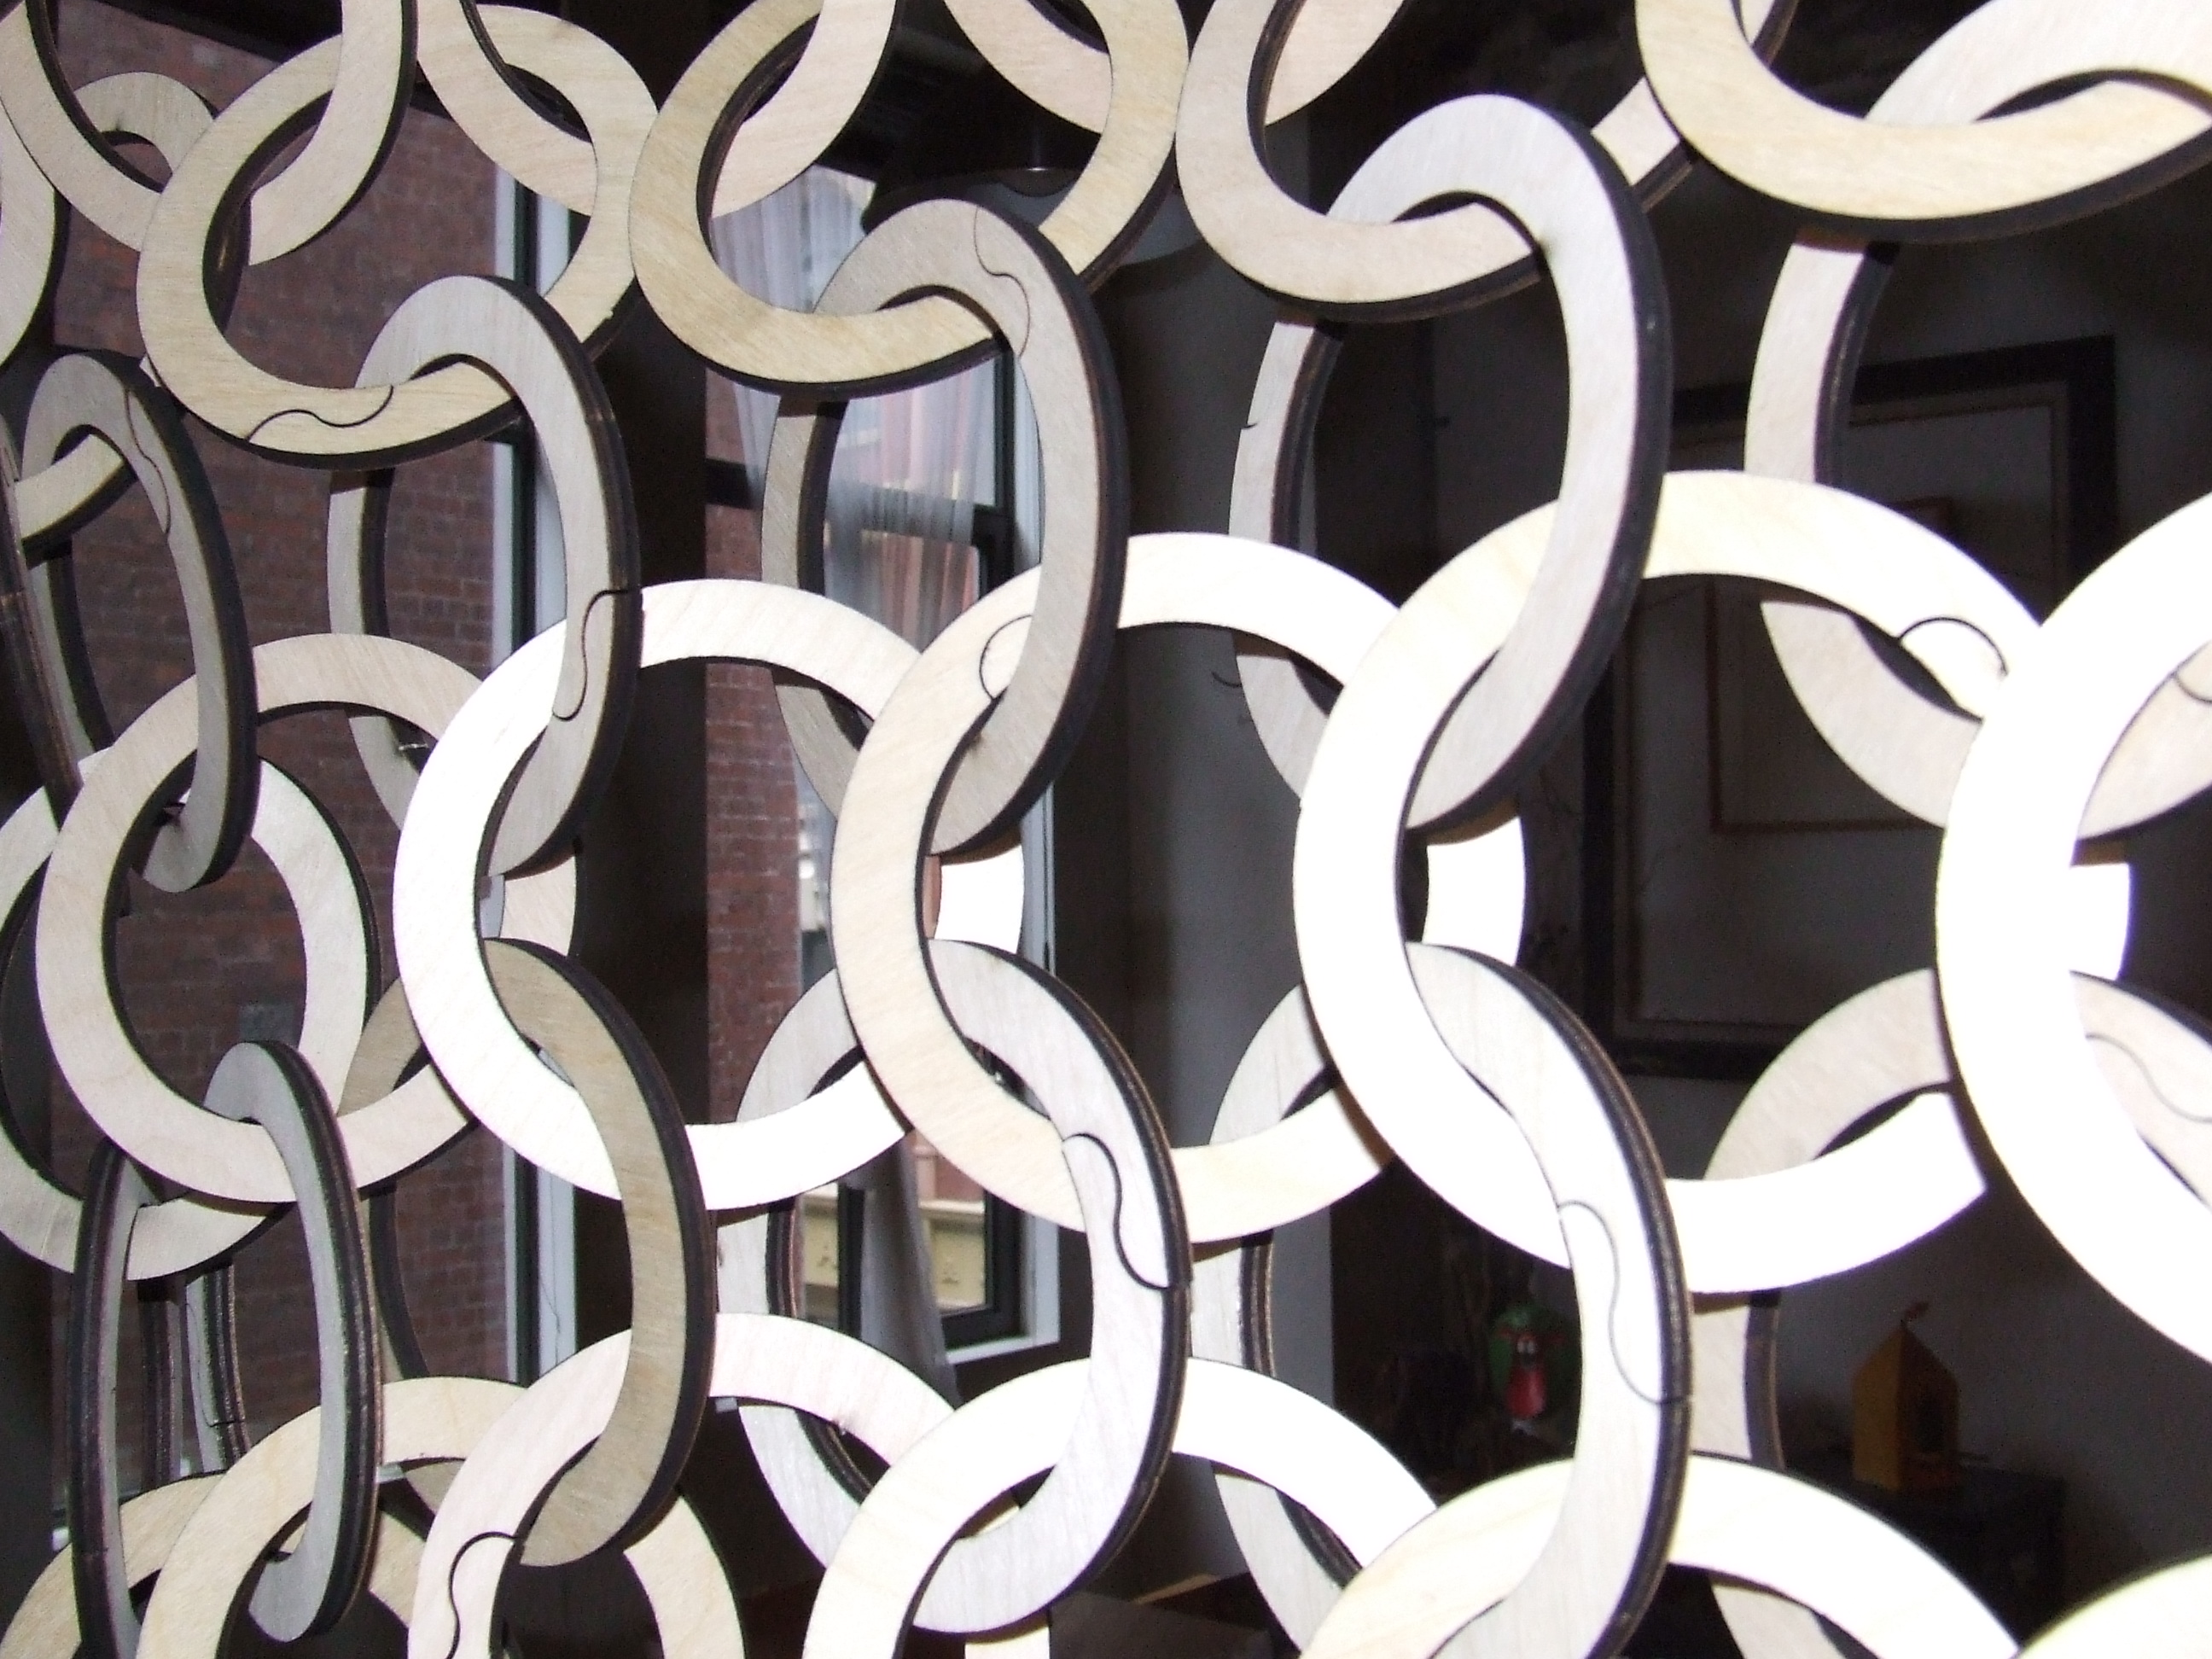
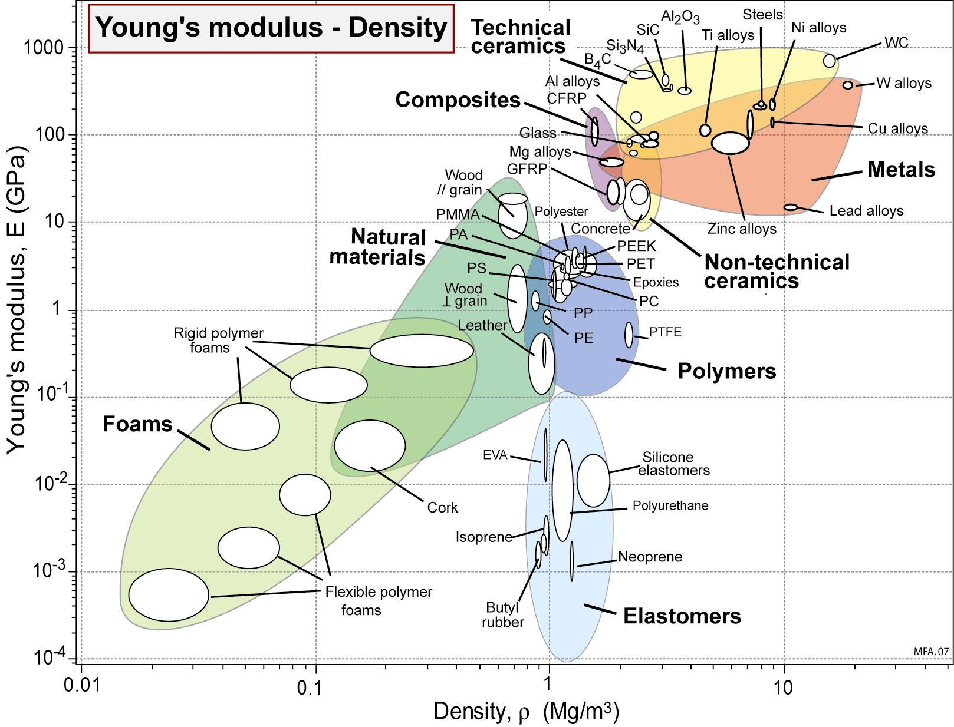
Flexibility
Looking for a light & stiff material? A chart of Young’s modulus (Elasticity) and density for materials guides the choice.
The chart was created using the CES EduPack 2007 software with the Level 2 database. Granta Design

Slide 30
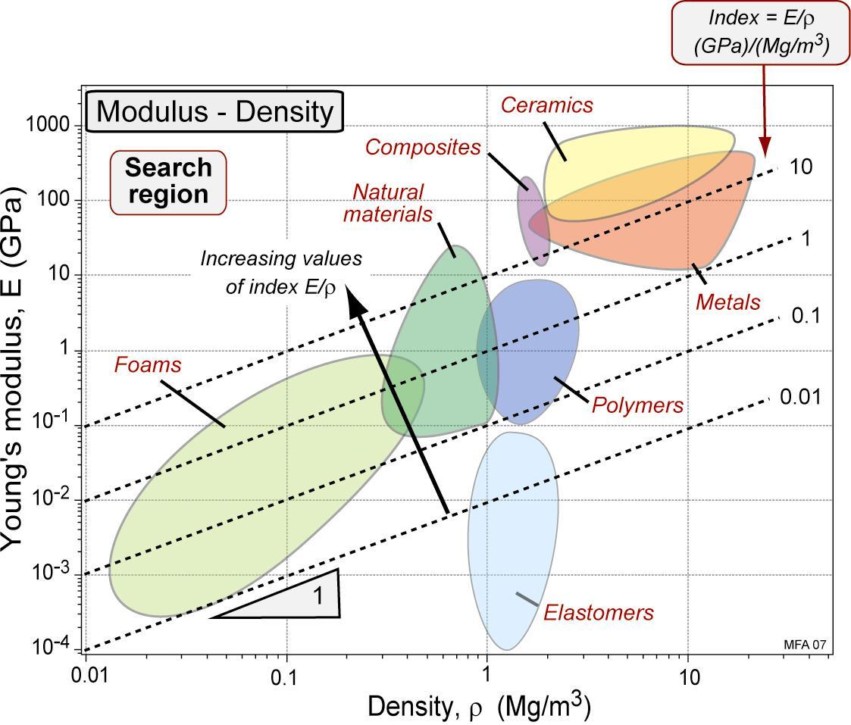
Flexibility
The index E/, describing the objective of stiffness at minimum weight, plotted on a chart. The best choices are materials with the greatest value of E/ that at the same time meet all other constraints. Granta Design

Slide 31
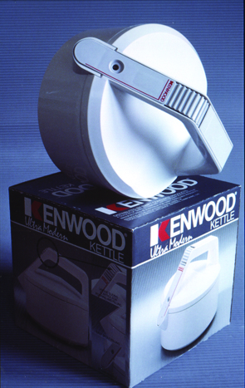
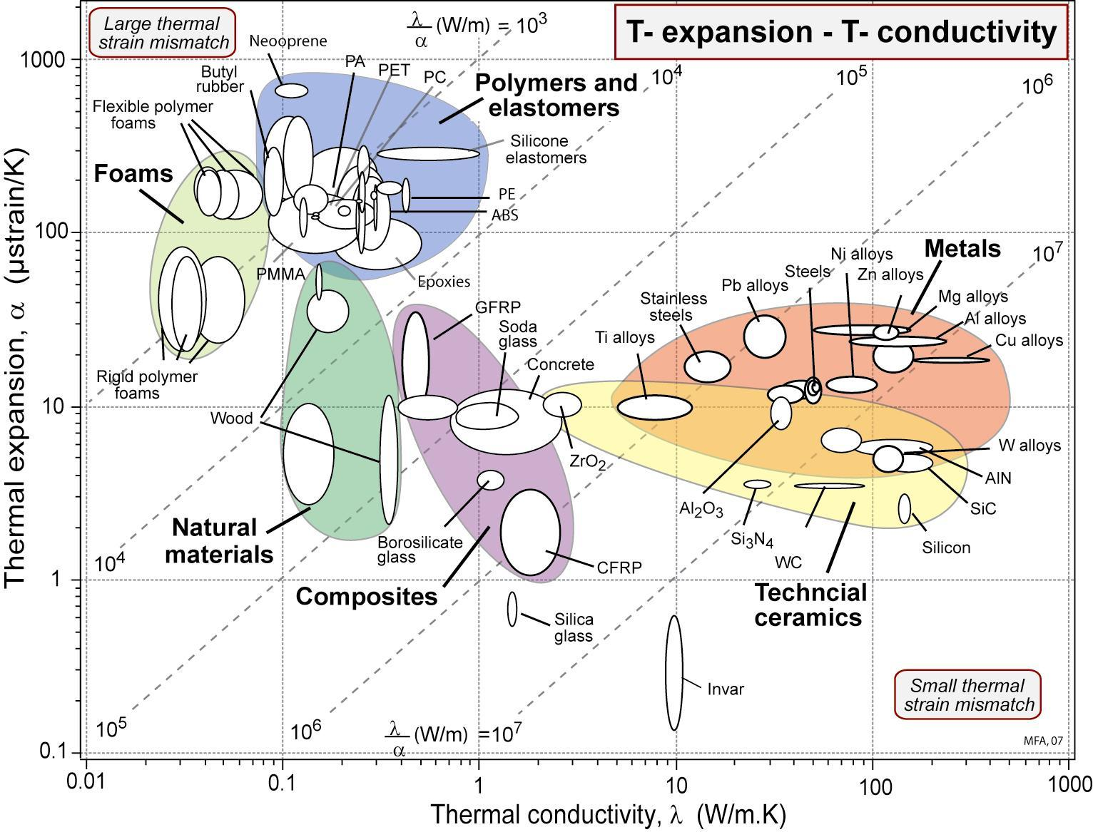
Thermal properties
Looking for a material with low thermal expansion or expansion that matches another material? A chart of thermal conductivity and thermal expansion for materials is instructive.
The chart was created using the CES EduPack 2007 software with the Level 2 database. Granta Design

Slide 32
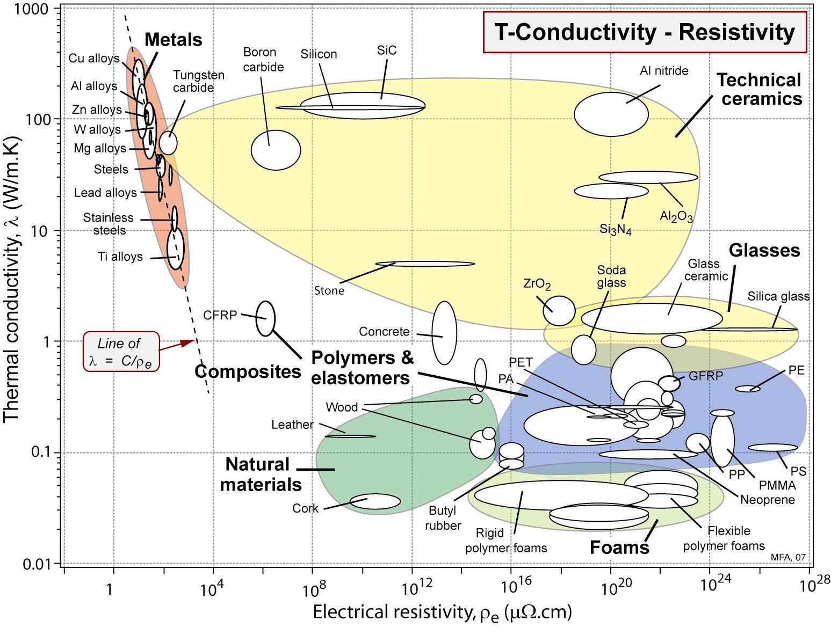
Conducts heat & insulates
Need a material that conducts heat well but is an electrical insulator? A chart of thermal conductivity and electrical resistivity for materials may provide answers.
The chart was created using the CES EduPack 2007 software with the Level 2 database. Granta Design

Slide 33
Family, Class & Member Profile

Slide 34
Family, Class & Member Profile

Slide 35
Shaping, Joining & Surface

Slide 36
Shaping, Joining & Surface

Slide 37
Shaping, Joining & Surface

Slide 38
Intuition & perspective
The charts put material properties in perspective; For example;
Metals are 20 to 100 times stiffer than polymers and can conduct heat 100 times faster.

Slide 39
Intuition & perspective
The charts put material properties in perspective; For example;
Metals are 20 to 100 times stiffer than polymers and conduct heat 100 times faster.
Elastomers have enormous expansion coefficients but are excellent electrical insulators.

Slide 40
Intuition & perspective
The charts put material properties in perspective; For example;
Metals are 20 to 100 times stiffer than polymers and conduct heat 100 times faster.
Elastomers have enormous expansion coefficients but are excellent electrical insulators.
This “order of magnitude” familiarity is useful;
Much engineering design is intuitive.
Intuition is informed by just this sort of familiarity.

Slide 41
Map your autopsy
Classify each component material as
Family
Class / Sub-class
Member
Profile
Classify each component process as
Family
Class / Sub-class
Member
Profile
Plus Aesthetic attributes & Perceptions of attributes

Slide 42
Materials autopsy

Slide 43
Process autopsy

Slide 44
Homework
Submit assignment 1
For details, see http://www.studiobutcher.com/sb-aide-week-4.html

